Slide 1
Unit - II
DIGITAL MARKETING STRATEGY DEVELOPMENT

Slide 2
Digital Marketing Assessment Phase
Elements of the Assessment Phase
Marketing Strategy and its Digital Shifts
Analyzing marketing opportunities - identify
Developing marketing strategies- positioning strategy
Planning marketing programs- cost
Managing the marketing effort – feedback &control

Slide 3
The key differences in marketing strategy/framework creation traditionally and with the advent of digital media include:
Knowledge of customer preferences
Leveraging traditional brand presence
Reactive to predictive approach
Disintermediation of value chains/life cycles
Impact of prosumerization
Brand to channel attribute alignment
Unique digital-connect concepts
Follow-the-customer model (attribution concepts)

Slide 4
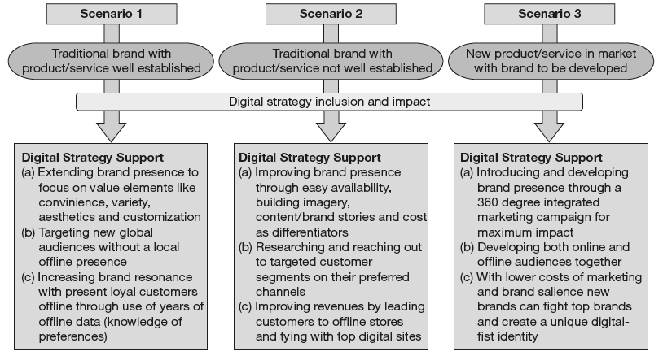
The Need for Digital Strategy

Slide 5
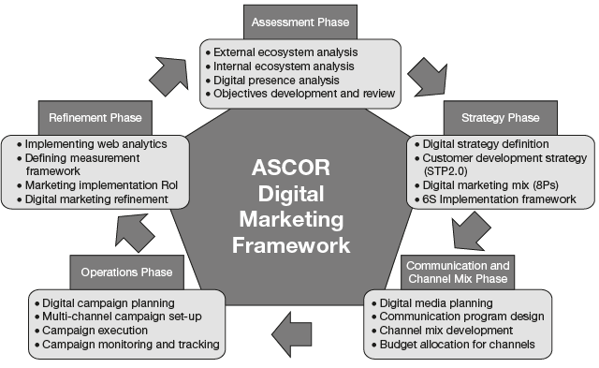
The Assessment Phase Elements

Slide 6
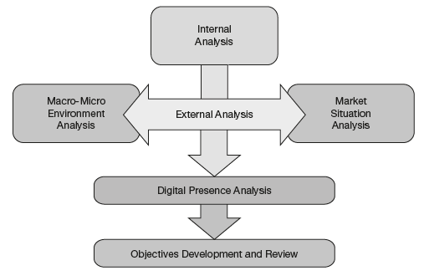
Understanding the Assessment Phase

Slide 7
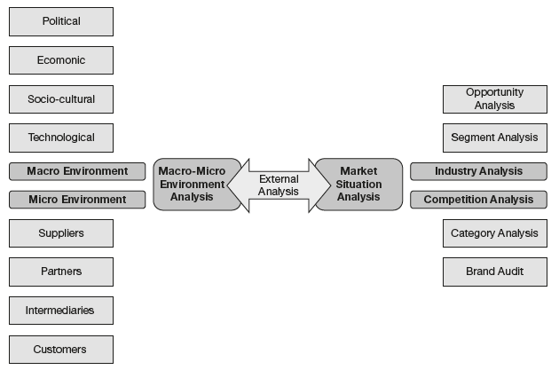
Understanding Macro-Micro Environments

Slide 8
Marketing Situation Analysis
(a) Industry analysis: involves conducting market research to analyze key industry trends related to marketer’s product/service on digital platforms.
(b) Competition analysis: includes researching direct and indirect competitors to compare a marketer’s product portfolio. It also helps assess the leverage digital marketing can provide to a brand’s objective of positioning itself online.

Slide 9
Application of Market Research
(a) Primary research: consists of a collection of original primary data collected from the field by the researcher using questionnaires, focus group discussions, interviews, etc.
(b) Secondary research: involves the summary, collation and synthesis of existing research available from multiple sources like research papers, previous experiments, articles, etc.

Slide 10
Industry analysis
(a) Market segment analysis: Let us suppose, a firm—XYZ—plans to launch a new mobile phone in the market. Even before it starts to develop a product, the firm needs to conduct enough research to understand the market segment and its data points.
(b) Opportunity analysis: Apart from research on industry and specific market segment, the firm would also need a market opportunity sizing exercise with the help of the research data

Slide 11
Competition analysis
(a) Category analysis: This element of competition analysis maps the specific category of product (which in our present example is the mid-range smart phone category) to understand key competitors and defining elements which would make the product stand apart in the wake of competition.
(b) Brand audit: It involves conducting an analysis of key brand attributes against competing brands to realize intangible factors like brand value, imagery, perception, and other unique value elements which differentiate it in the market and would make it stand out in its category.

